Slide 1

Smart Home Automation
Presented by: [Ayush Galiyan]

Slide 2
Problem Statement
Need
Need for safer, energy-efficient, and convenient homes.
Automate
Automate daily tasks to avoid manual errors.
Handle
Handle emergency cases like gas leakage or intrusions.

Slide 3

Project Objective
Automate appliances and safety systems.
Use sensors to detect motion, gas, and light.
Display real-time data on LCD screen.

Slide 4

Components Used
Arduino Uno R3
PIR Sensor, LDR, Gas Sensor, Ultrasonic Sensor
Relay, LCD 16x2, DC Motor, Light Bulb
Power Supply, Resistors

Slide 5
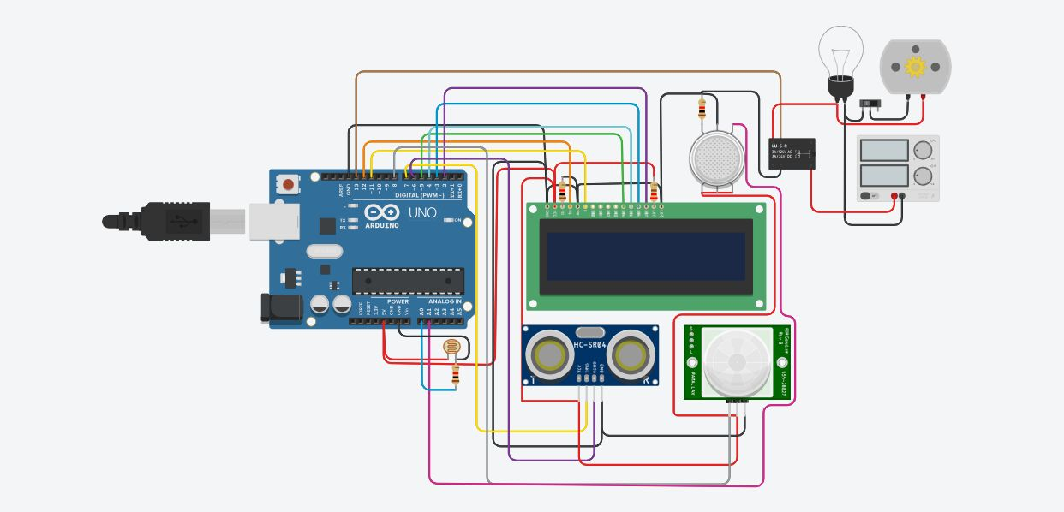
Circuit Diagram

Slide 6
Working Principle
Sensors send input to Arduino Uno.
Arduino processes conditions for gas, motion, and light.
Appliances controlled via relay and outputs shown on LCD.

Slide 7
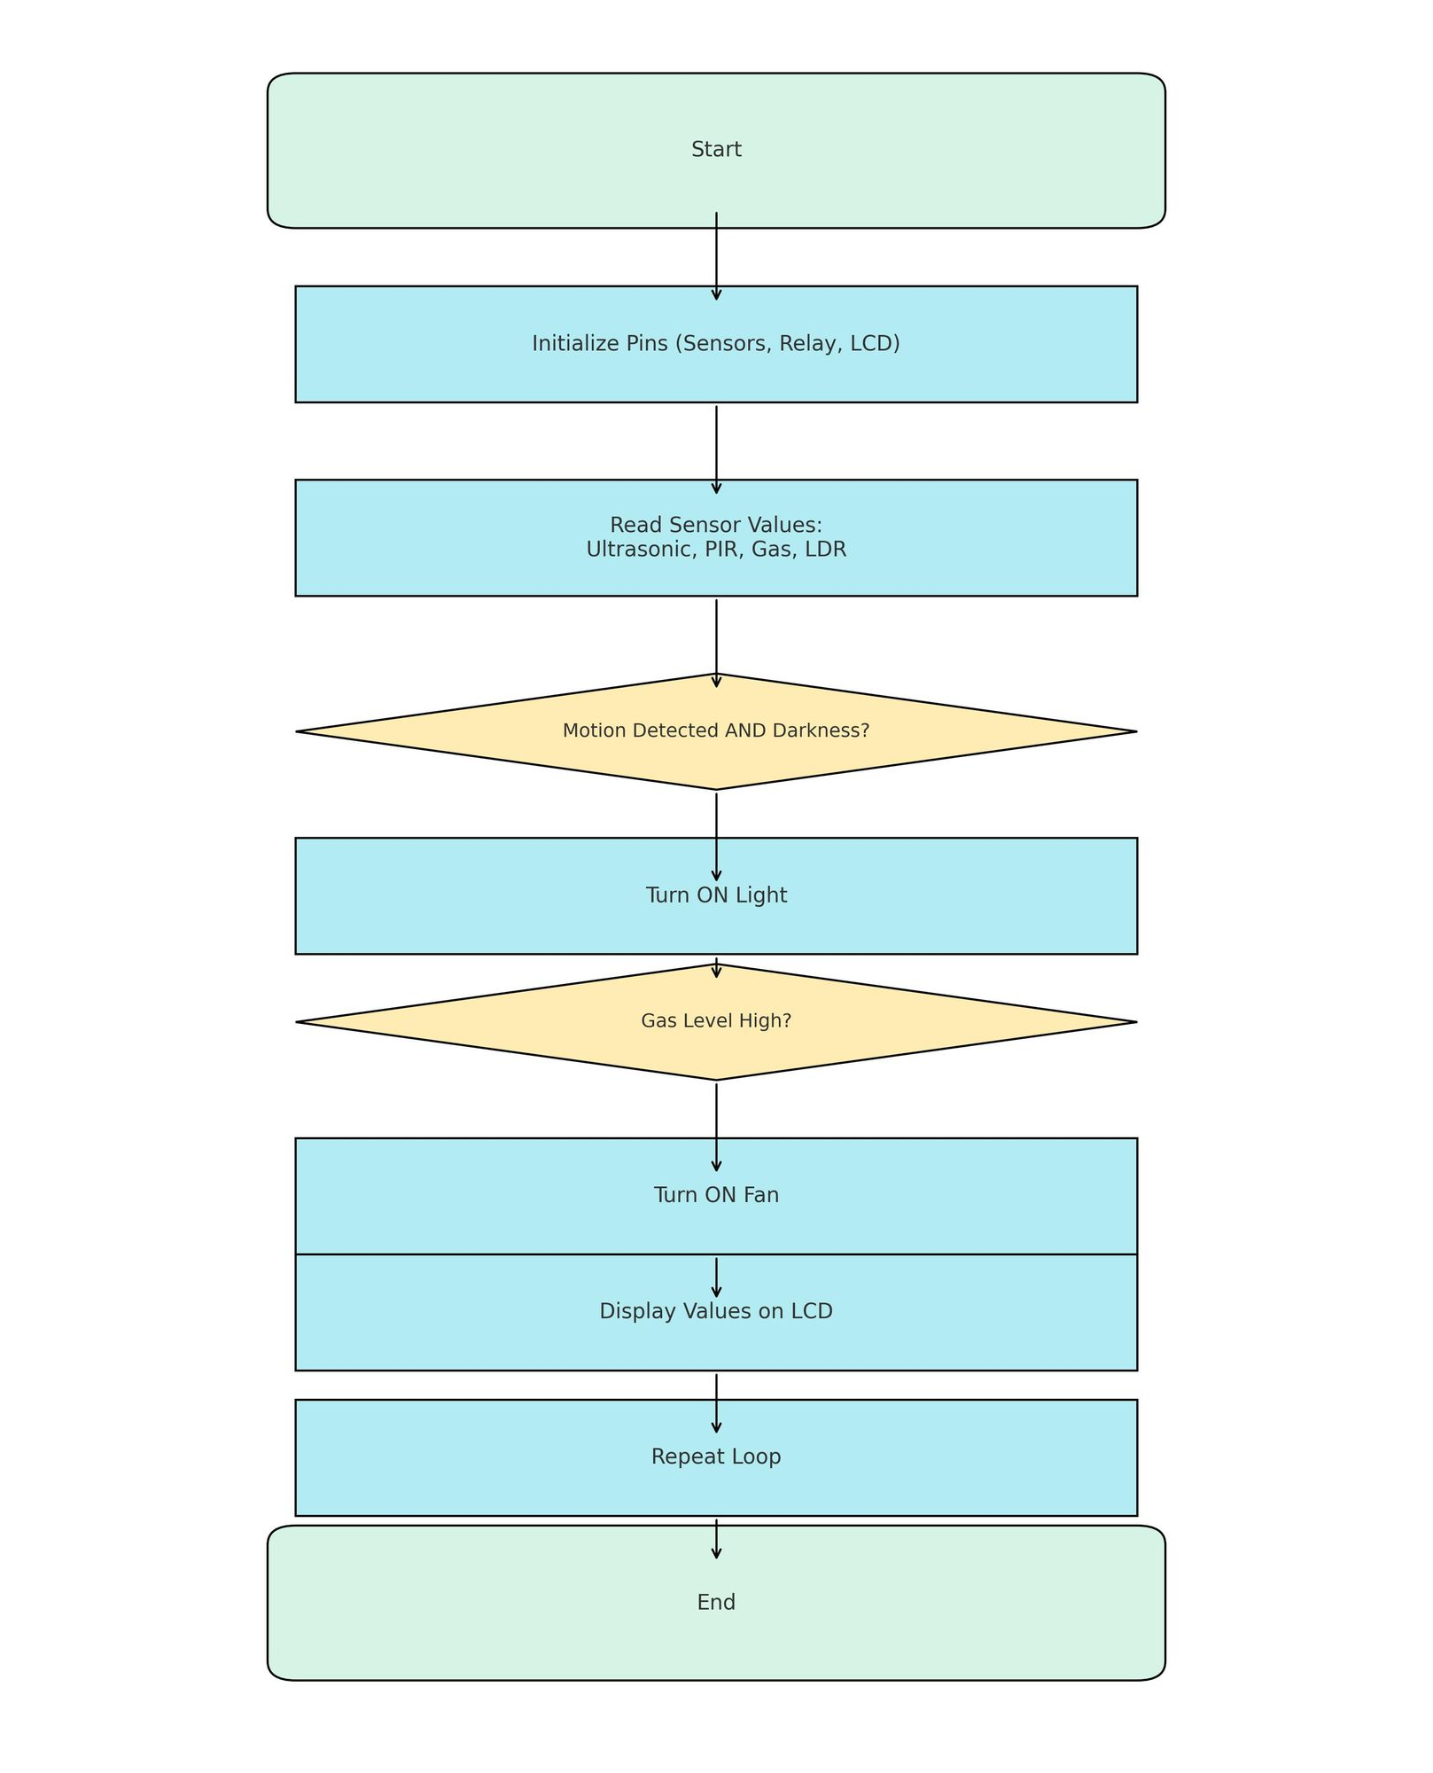
Code Logic Overview

Slide 8
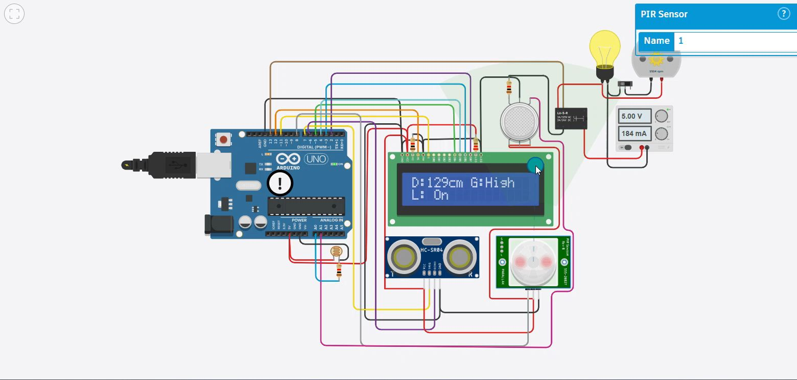
Real-Time Output

Slide 9

Applications
Home Automation and Energy Efficiency
Security and Intrusion Detection
Gas Leak Warning System
Elderly Care Monitoring

Slide 10

Future Improvements
IoT integration for remote control
Voice assistant compatibility (Alexa, Google)
Mobile app control and alerts
Additional environmental sensors

Slide 11
Conclusion
Smart home automation improves safety and comfort.
Real-time monitoring via sensors and LCD display.
Project demonstrates practical use of embedded systems.

Slide 12

Thank You

